Slide 1
ASSOCIATION LOGO
TITLE OF YOUR POSTER
Author names
OTHER LOGO OR IMAGE
Affiliation names
Profile Photo
This slide/poster size is 40.97 inches by 23.04 inches (16:9 aspect ratio). If you are creating your own template on PowerPoint 2011, go to File -> Page Setup if you and enter above dimensions. All of our ePosterBoards templates have been preset with the correct formats.
Minimum font: 28pt (this may seem large, but at this poster size it’s not)
Recommended font Types: Calibri, Arial, Times New Roman
Multiple pages can be used. Multiple page allows adequate spacing for adding more content, images, graphs and videos
Abstract
Introduction
Methods
Main Author
Results 1
Results 2
Conclusion
Please use the headings above to navigate through the different sections of the poster
Image

Slide 2
ASSOCIATION LOGO
TITLE OF YOUR POSTER
Author names
OTHER LOGO OR IMAGE
Affiliation names
Intro
VIDEO
Content
Content
Content:
Content Content
Content Content
Content
Abstract
Introduction
Methods
Results 1
Results 2
Conclusion
Topic
Please use the headings above to navigate through the different sections of the poster
Content
Content
Content
Content
Objective
Image
Content
Content

Slide 3
ASSOCIATION LOGO
TITLE OF YOUR POSTER
Author names
OTHER LOGO OR IMAGE
Affiliation names
Image
Topic
Content
Content
Content
50% → 60% → 70% → 80% → 88%
Content
Abstract
Introduction
Methods
Results 1
Results 2
Image
Conclusion
Please use the headings above to navigate through the different sections of the poster
Topic
Content
Content
Content
Content
Content
Content
Image

Slide 4
ASSOCIATION LOGO
TITLE OF YOUR POSTER
Author names
OTHER LOGO OR IMAGE
Affiliation names
Image
Topic
Content
Content: Content
Content: Content
Example: Content
Content
Abstract
Introduction
Methods
Results 1
Results 2
Conclusion
Topic
Model
Model
Model
Content
Content
Content:
Content
Content
Content
Content
Please use the headings above to navigate through the different sections of the poster
Image
Topic
Content
Content

Slide 5
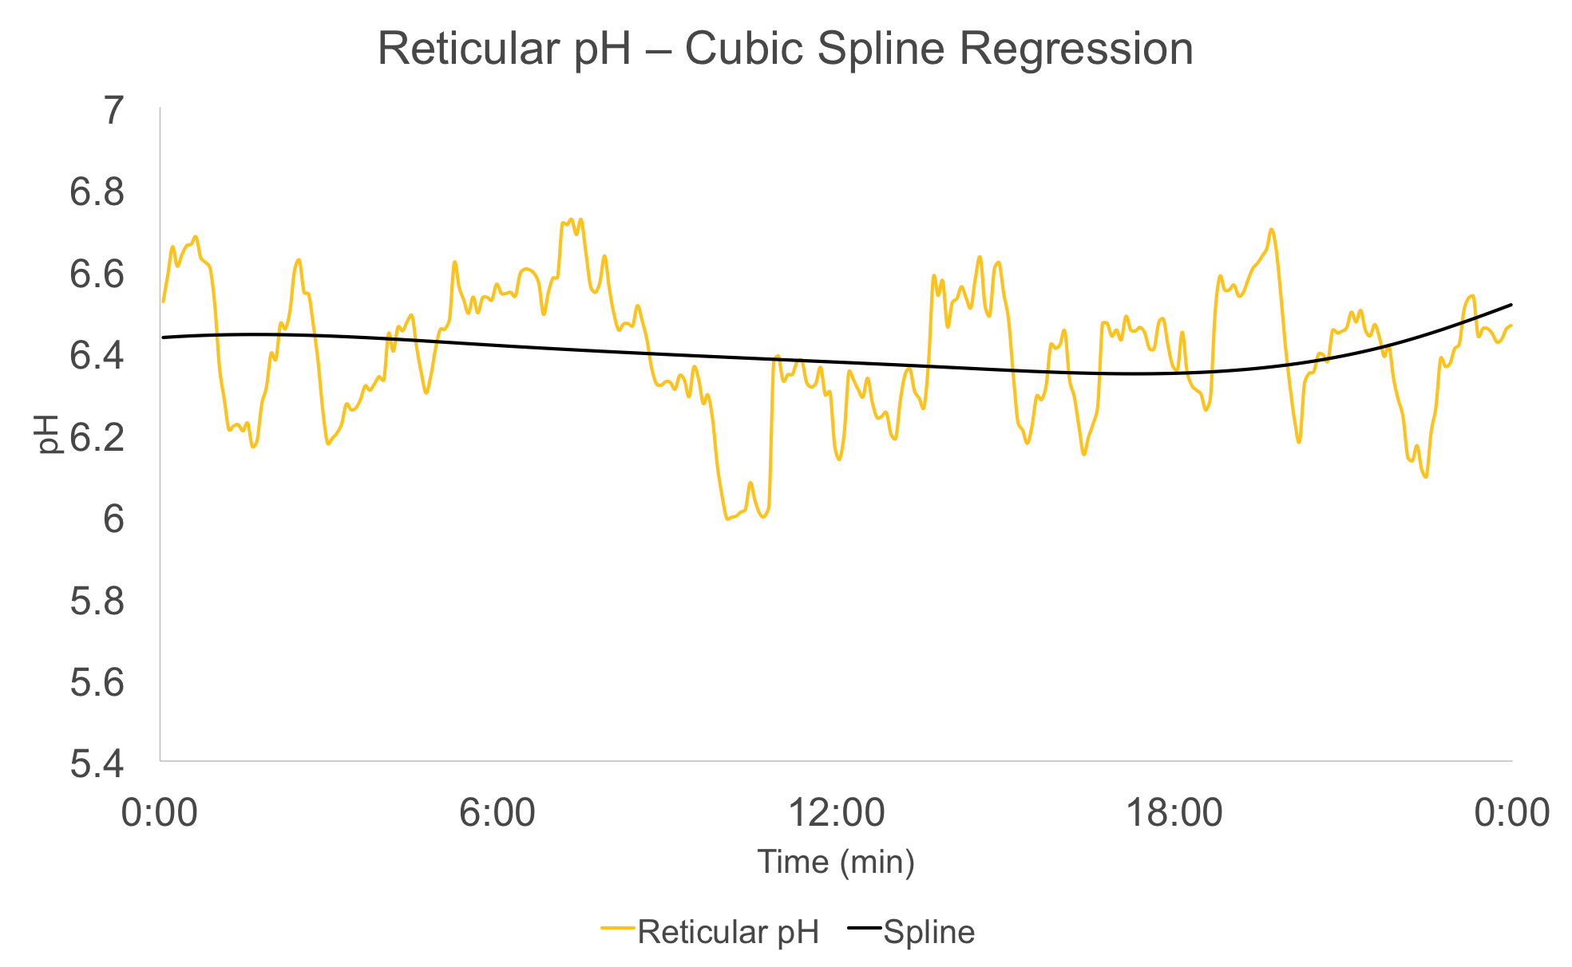
ASSOCIATION LOGO
TITLE OF YOUR POSTER
Author names
OTHER LOGO OR IMAGE
Affiliation names
Topic
Content
Below is a formula that has been added as a .png
Content
Content
Content
Abstract
Introduction
Methods
Results 1
Results 2
Conclusion
Please use the headings above to navigate through the different sections of the poster
Topic
Graphs have been saved as .png to ensure all values remain as they can disappear when changing operating systems
Always save your graphs/tables as .png
Content
Content
Content
Content
Image

Slide 6
ASSOCIATION LOGO
TITLE OF YOUR POSTER
Author names
OTHER LOGO OR IMAGE
Affiliation names
DID YOU FOLLOW THESE STEPS?
Abstract
Slide/ePoster Size: 40.97 inches by 23.04 inches. Presentation slides should be set to this size, which is a 16:9 Ratio at 1080p resolution (1920 X1080 pixels)
Font Size: Larger than 28 points
Font type: Arial, Calibri, Times New Roman
Embedded videos can only be displayed in the following formats:
.mov, .mp4, .m4v and mpeg *Upload file along with your presentation
Check all your hyperlinks to make sure it goes to your desired slide
Save all mathematical formulas to images (.jpg, .png) when embedding or upload your excel file along with your presentation
Slide Show Toolbar: Select “Setup Slide Show” then select “loop continuously until stopped”
Save as .pptx to ensure all your embedded images and video are included
Layout should always be in landscape orientation & recommended 1-6 slides max unless you hyperlink
Introduction
Methods
Results 1
Results 2
Conclusion
Please use the headings above to navigate through the different sections of the poster
References
Image
AlZahal, O., B. Rustomo, N. E. Odongo, T. F. Duffield, and B. W. McBride. 2007. Technical note: A system for continuous recording of ruminal pH in cattle. J Anim Sci 85(1):213-217.
Cassell, D. L. 2007. Don't Be Loopy: Re-Sampling and Simulation the SAS Way. in SAS Global Forum 2007 Conference. S. I. Inc, ed. SAS Institute Inc.
Enemark, J. M. 2008. The monitoring, prevention and treatment of sub-acute ruminal acidosis (SARA): a review. Vet J 176(1):32-43.
Sato, S., A. Ikeda, Y. Tsuchiya, K. Ikuta, I. Murayama, M. Kanehira, K. Okada, and H. Mizuguchi. 2012. Diagnosis of subacute ruminal acidosis (SARA) by continuous reticular pH measurements in cows. Vet Res Commun 36(3):201-205.
Zhang, Y. and Y. Yang. 2015. Cross-validation for selecting a model selection procedure. Journal of Econometrics 187(1):95-112.

