Slide 1
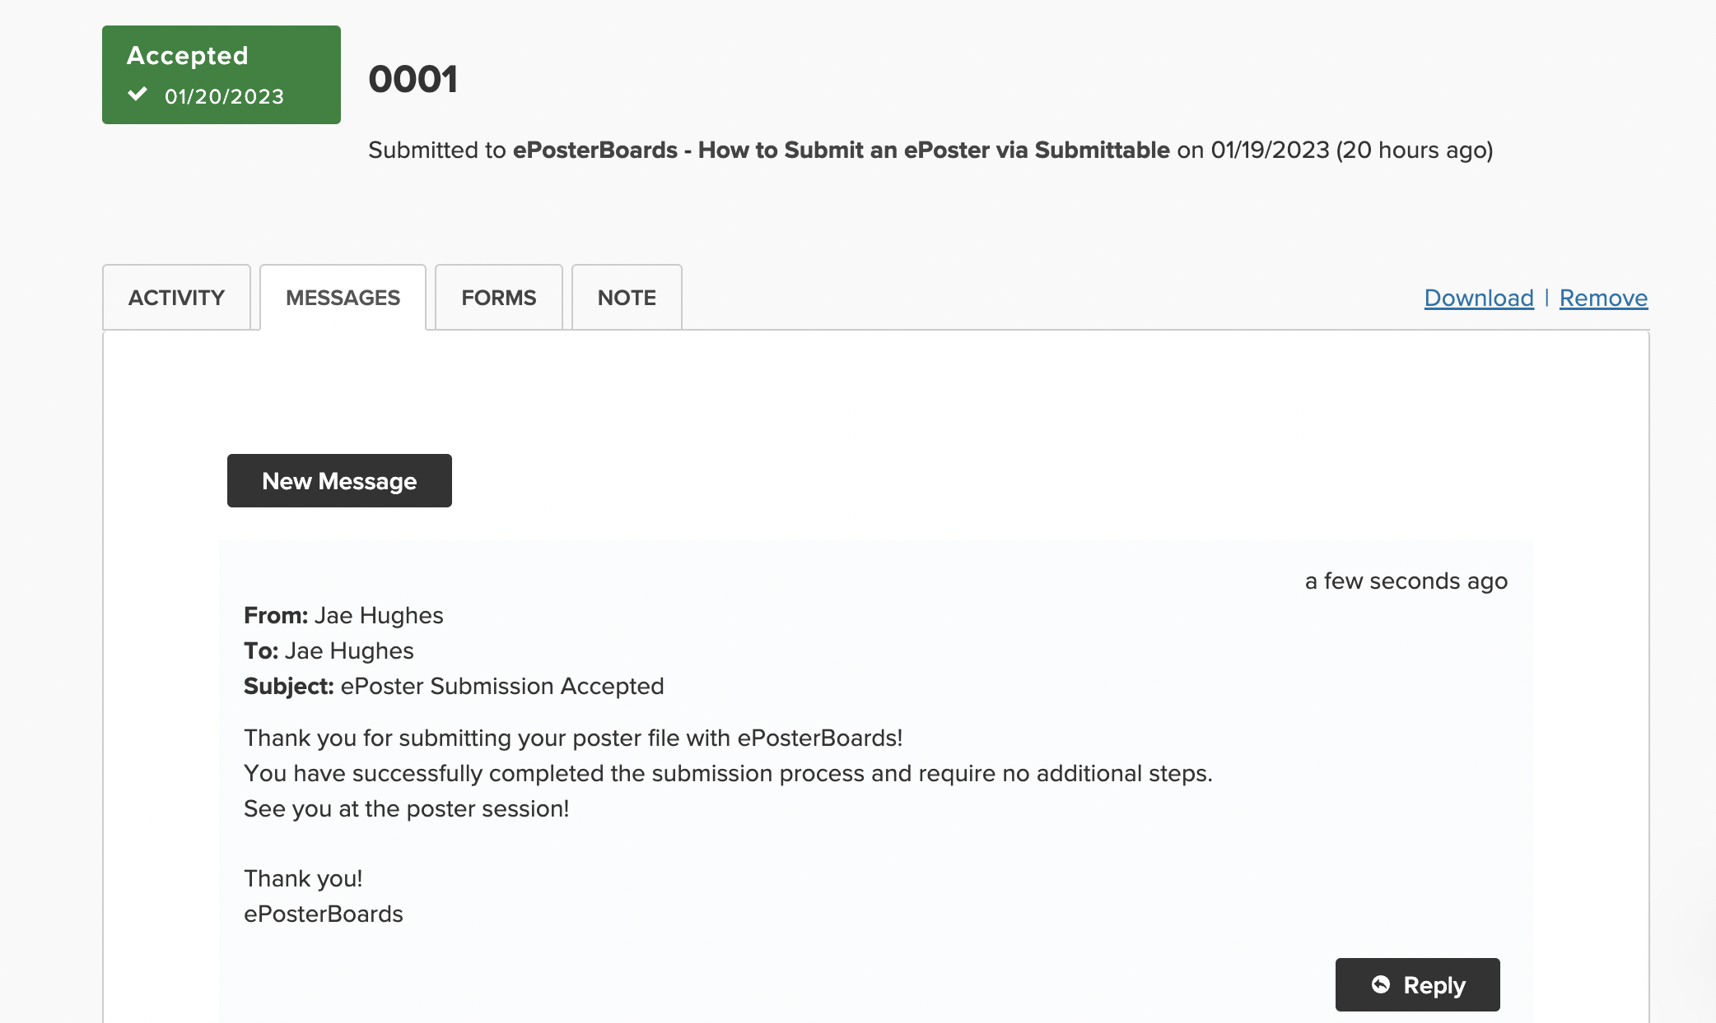
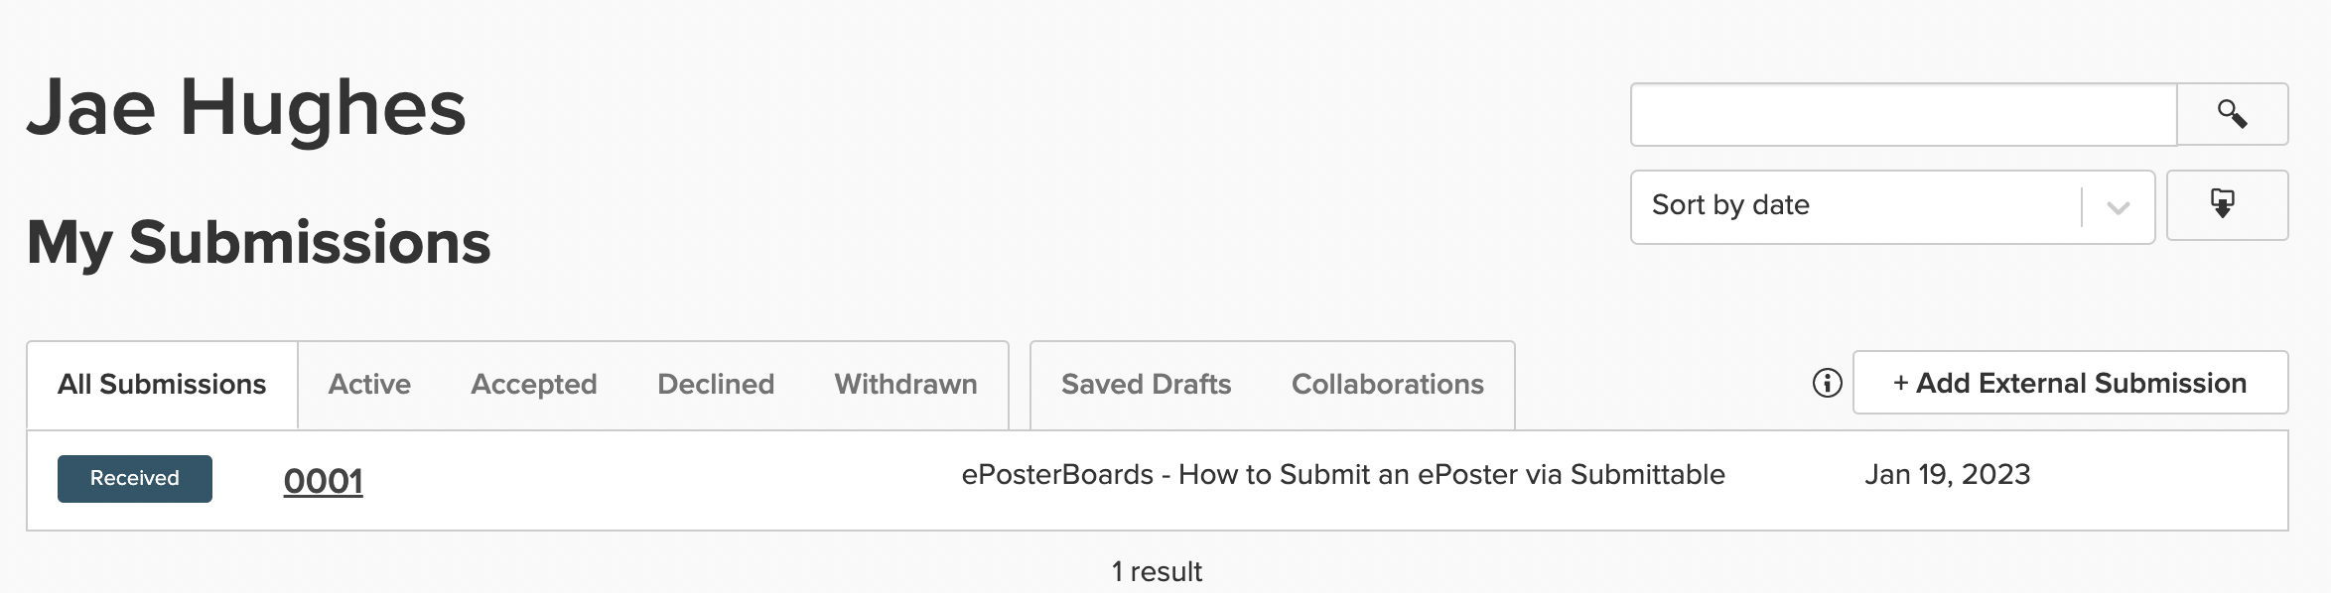
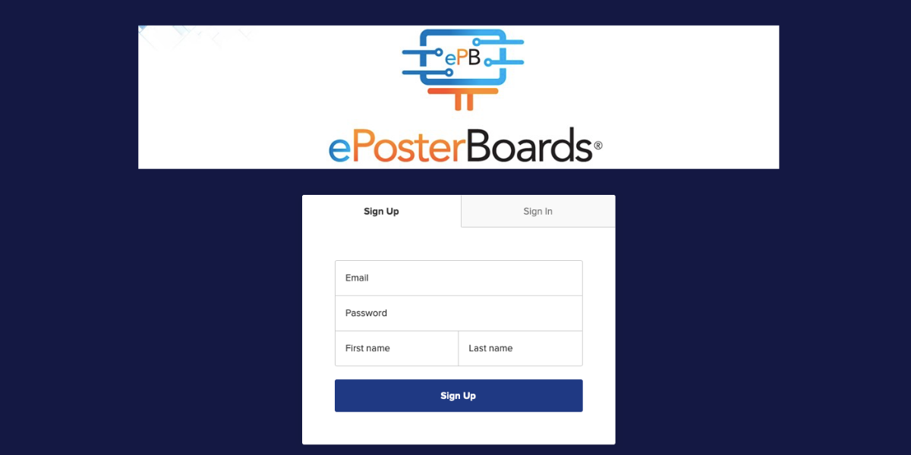
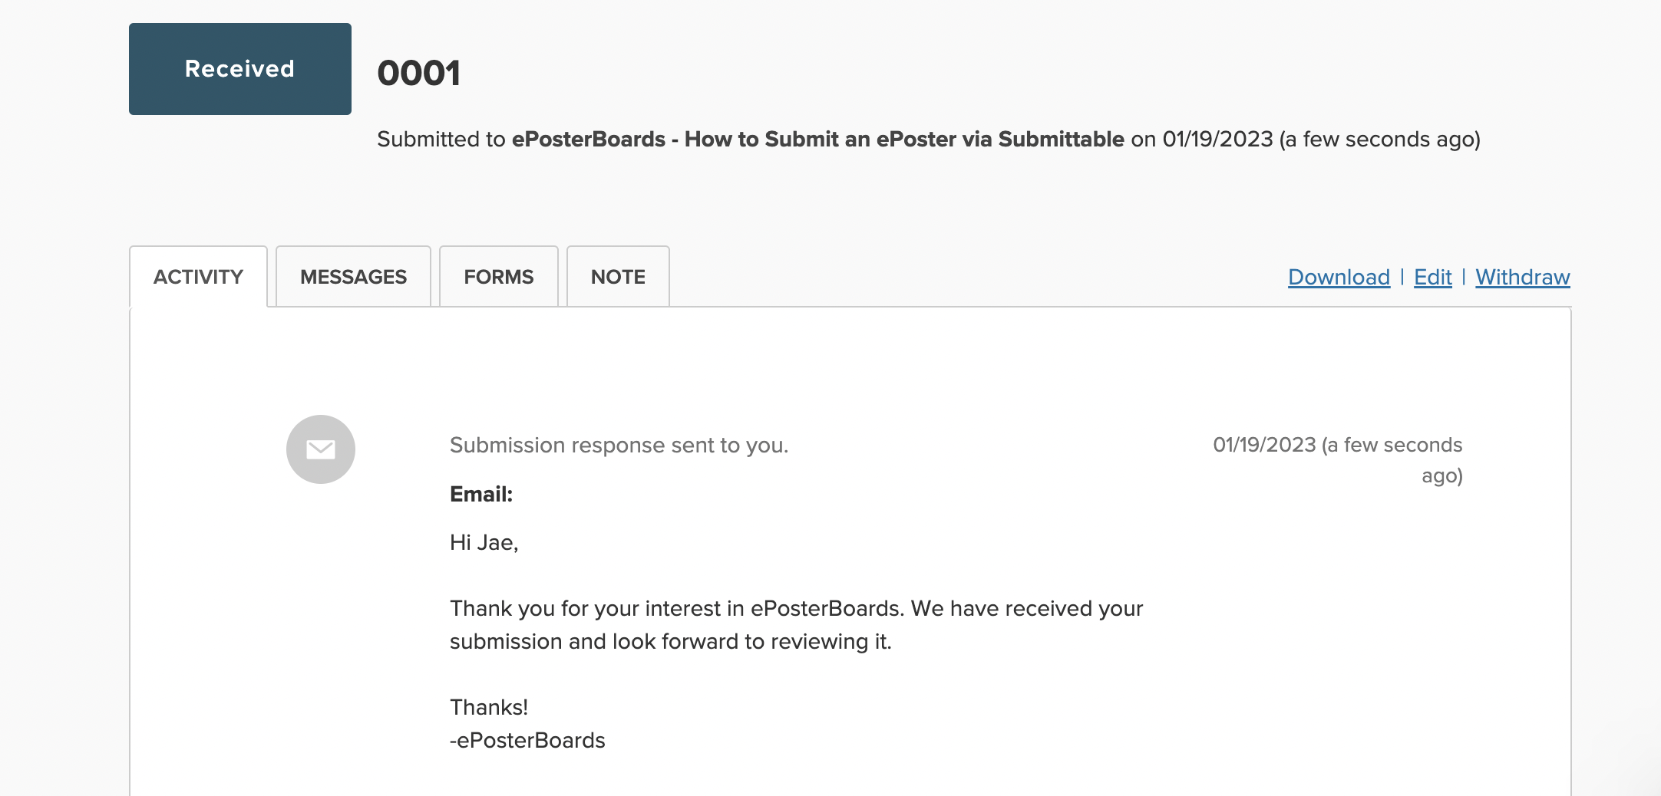
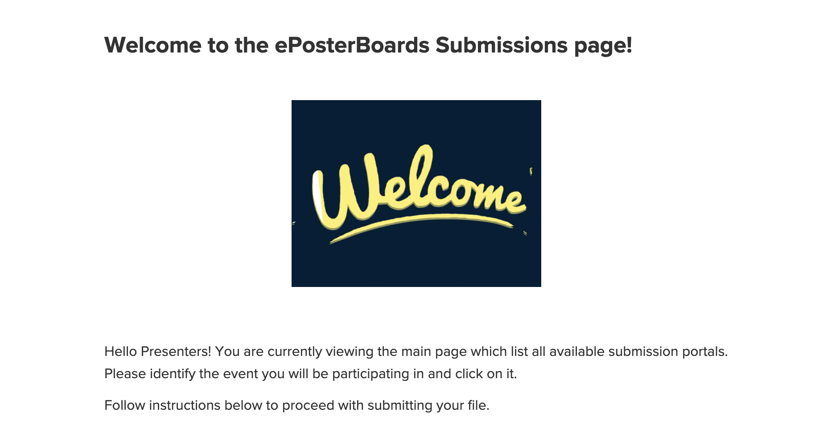
UPLOADING INSTRUCTIONS FOR SUBMITTABLE
#eposters
eposterboards.com
Step 1
Review your community site for the Upload Deadline
If you anticipate missing this deadline, please communicate with us ahead of time
Depending on the circumstances, you may need to upload your file, in person, using a flashdrive, during the event.
Step 2
Gather your files. Be sure to include the poster file, as well as any video files, as videos sometimes do not embed properly. Your file should be saved as “lastname.firstname” in a PPTX or PDF file.
Step 3
Go to our Submittable uploading page or Find the link on your community site: https://eposterboards.submittable.com/submit
Step 4
Click on your event, scroll to the bottom of the page and click “Create Your Account”. Set up your account by providing your email address and creating a password
Step 5
Follow the guidelines to fill out all required fields & upload your poster file. Contact ePosterBoards technical support if you have any questions.
In the “Additional Notes” section, please include any information that the ePoster staff will need to know regarding your presentation.
Step 6
Once you have filled out all required fields and uploaded your file, you will have access to your submissions dashboard. In the submissions dashboard you will be able to track the life of your poster, including when your file has been reviewed. On the dashboard you are also able to message ePosterBoards with any specific question/concern.
Please do not forget to follow-up on any submissions that have marked “Declined” during the review process
Step 7
If you need to upload a revised file, you must click on edit to send a message ePosterBoards on your submission dashboard, requesting for your file to become Editable.
Step 8
A notification will be emailed & sent to your dashboard as your poster file is received, reviewed, denied for additional editing, or accepted.
Step 9
After the review period, if your poster file has been approved, the submissions process has been completed.
Please reach to to confirm receipt of your poster if you do not receive an accepted email.
Step10
For any questions or concerns, please contact ePosterBoards tech support at http://www.eposterboards.com/support/

