Slide 1
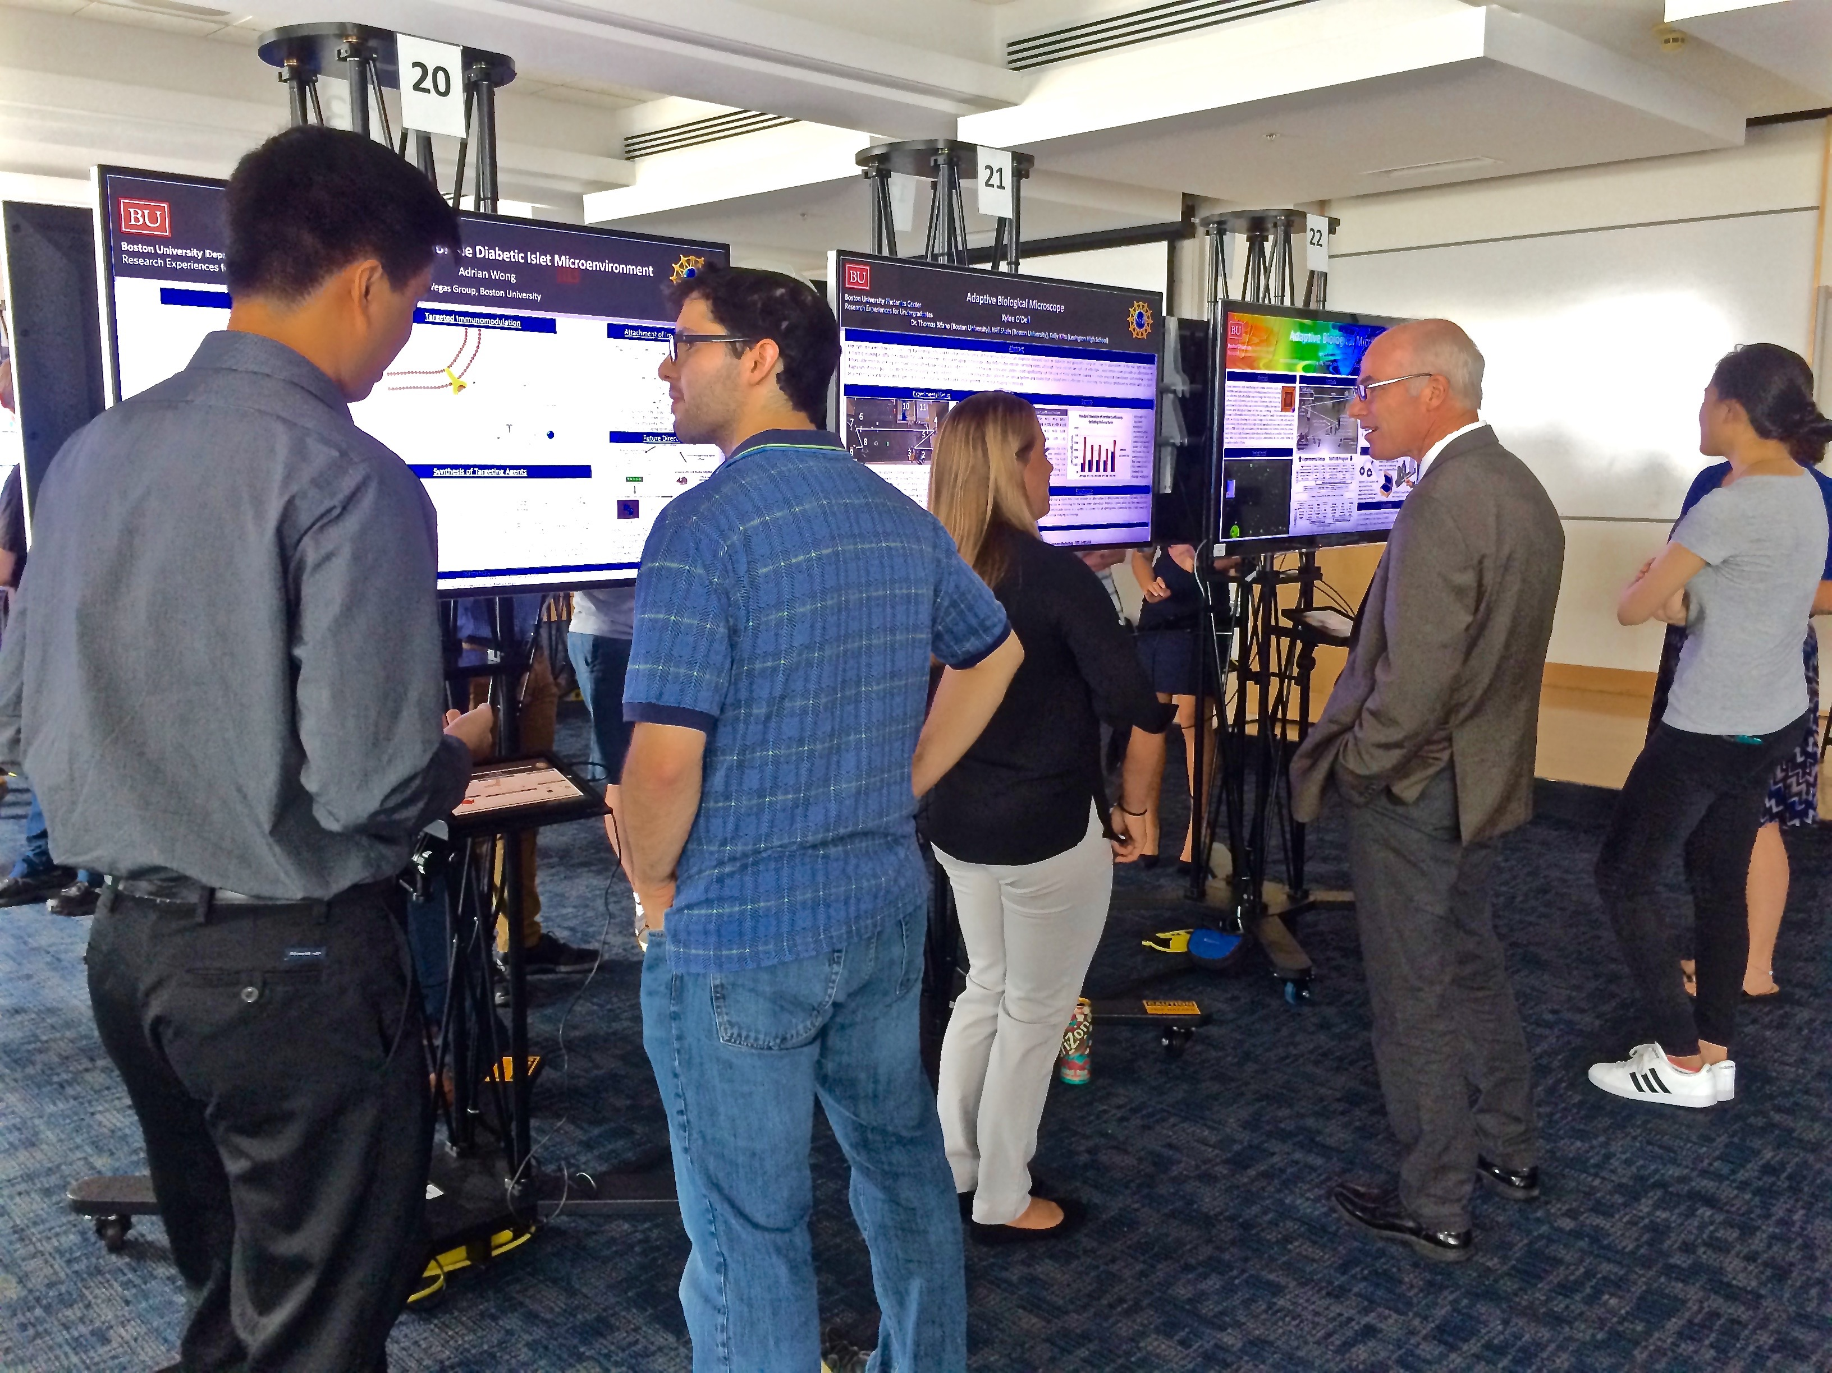
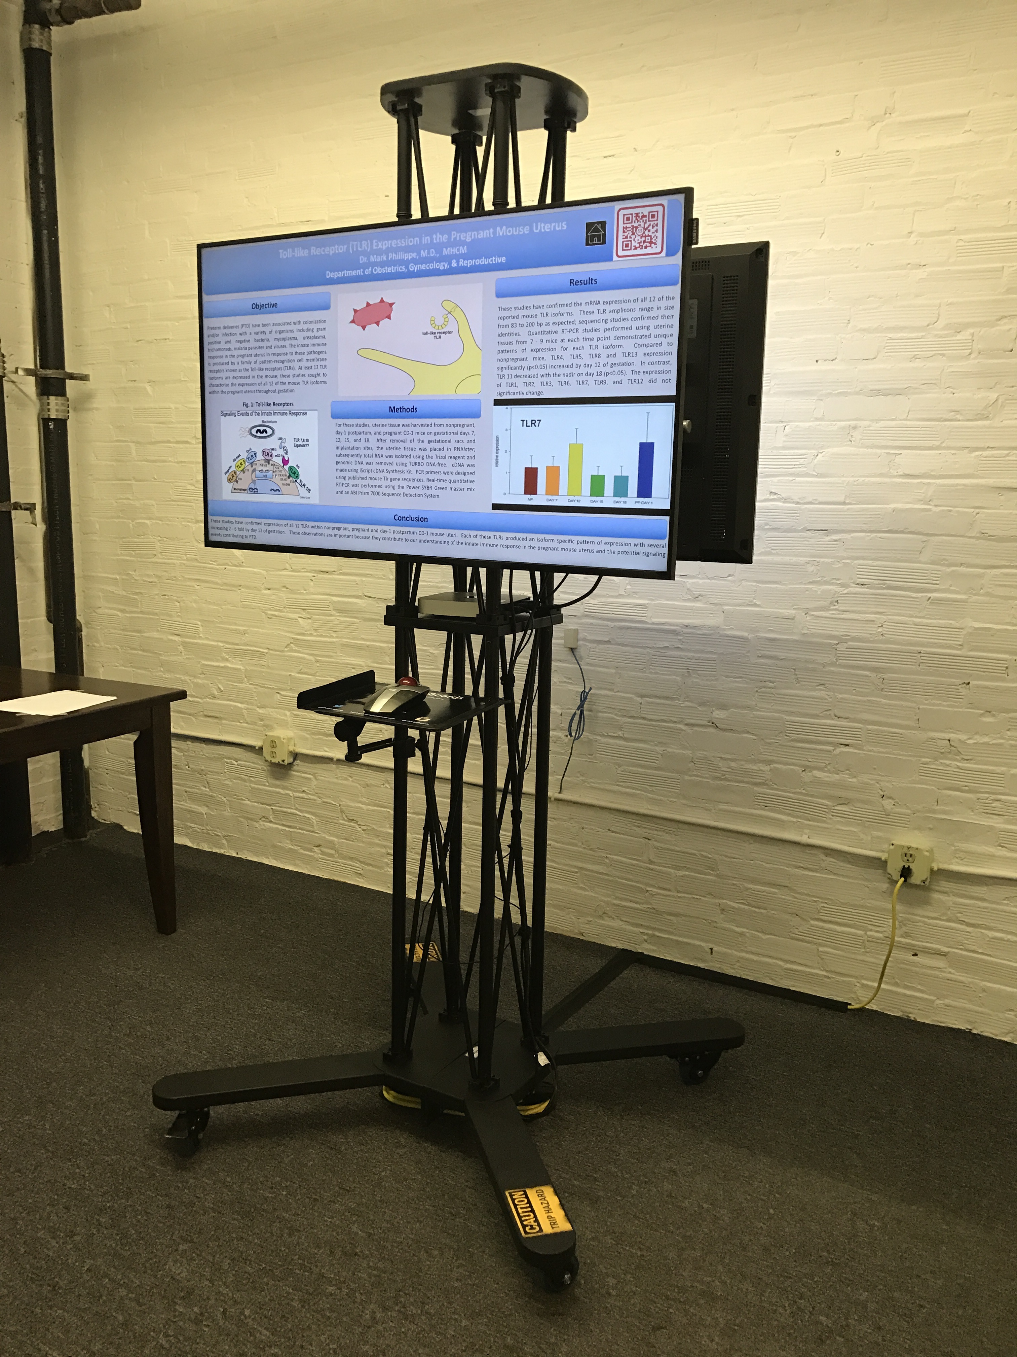
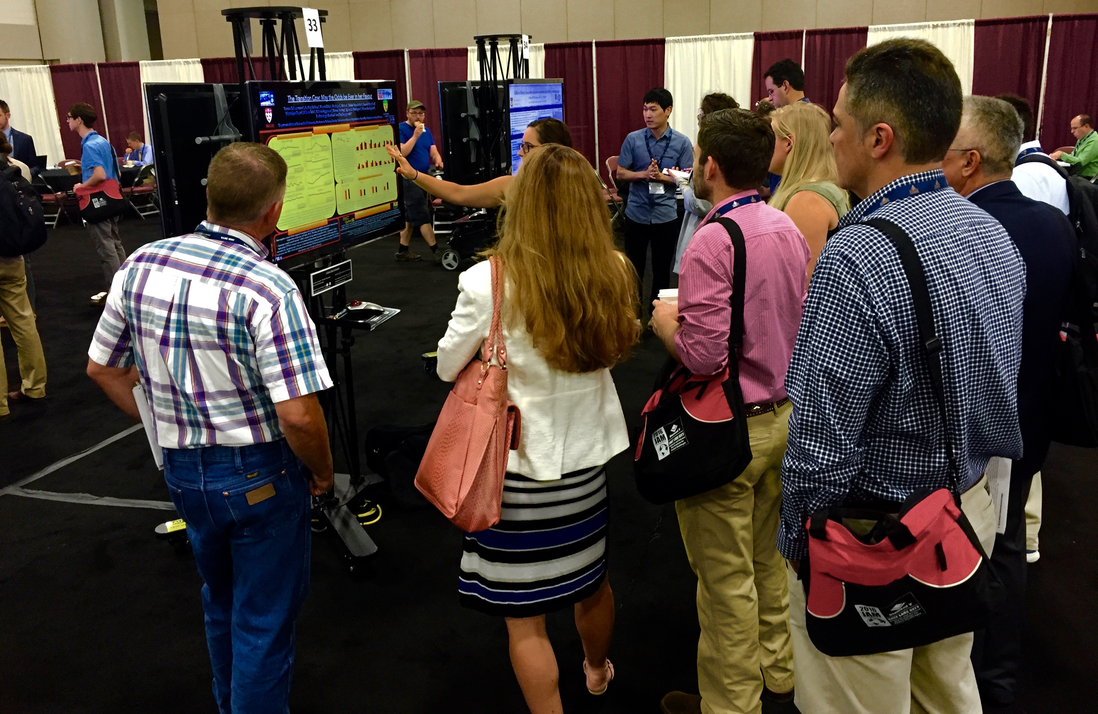
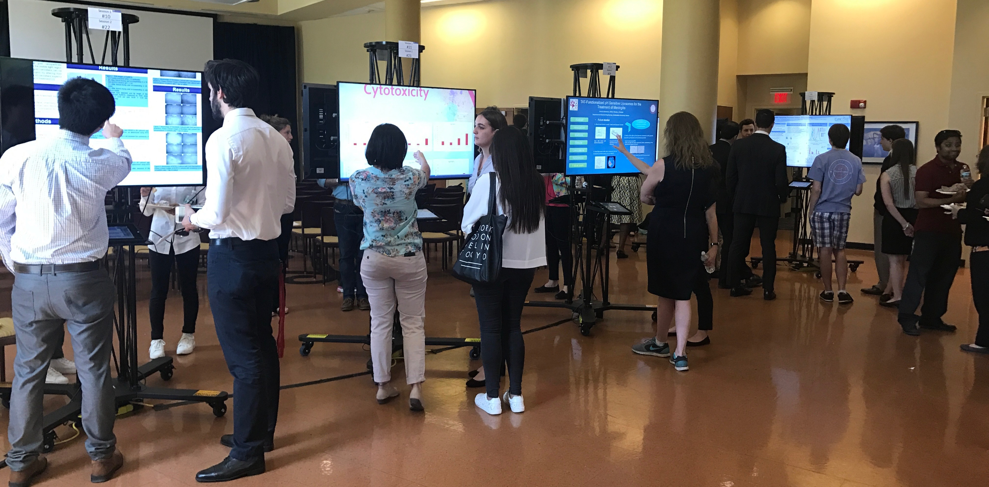
ePosterBoards Template
Author’s name
Affiliations
Introduction
This slide/poster size is 40.97 inches by 23.04 inches (16:9 aspect ratio)
Minimum font: 28pt (this may seem large, but at this poster size it’s not)
Recommended font Types: Calibri, Arial, Times New Roman
Multiple pages can be used. Multiple page allows adequate spacing for adding more content, images, graphs and videos
Figure 4. DESCRIPTION
Discussion
Did you follow our formatting steps?
Layout should always be in landscape orientation & recommended 1-5 slides max unless you hyperlink.
Check all your hyperlinks to make sure it goes to your desired slides
Slide Show Toolbar: Select “Setup Slide Show” then select “loop continuously until stopped”
Embedded videos can only be displayed in the following formats: .mov, .mp4, .mpeg. Note: Upload your video file along with your PowerPoint file.
Save all mathematical formulas and equations to images (.jpg, .png) when embedding or upload your excel file along with your PowerPoint file.
Save PowerPoint as .pptx to ensure all your embedded images and videos are included.
Methods
Figure 2. DESCRIPTION
This is only a template. All content may be modified. If you are creating your e-poster on a PC, please make sure to save your formulas and equations as an image (.jpg, .png) and embed it into your presentation or they will change on our Macs.
Figure 1. DESCRIPTION
Results
You can write your results in this text box
Figure 3. DESCRIPTION`

Slide 2
ePosterBoards Template
Author’s name
Affiliations
TOPIC
SECOND PAGE OPTIONAL
TOPIC
Content
This slide was added in case you do not have enough space on your first slide.
You can change the shapes and layout of this page by going to THEMES, EDIT MASTER, MASTER VIEW and EDIT 1st or 3rd slide.
Content
TOPIC
TOPIC
Content
Content
TOPIC
Content

